Slide 1

Welcome to Mrs. Boyd’s Curriculum Night
2nd Grade
Patterson Elementary
2023 -2024

Slide 2

Growth Mindset
Even if you struggle with certain skills, your abilities aren’t set in stone.
Perseverance is rewarded.
Some things we learn take some time to become permanent and may not “stick” until much later.
Nobody is perfect. We are all human beings and not robots. Practice makes permanent – not perfect.
Mistakes are good and celebrated!!! They are proof you are learning and trying!

Slide 3
Discipline Plan
Classroom expectations (on wall)
Be Kind – each month has a different trait
Positive behavior is rewarded through Class Dojo.
Consequences for not following the rules include: Warnings, Meeting with Mrs. Boyd, Lost Dojo Points, Detention, School Wide Discipline Plan
Quiet Room – No homework, incomplete work, behavior (less than 75% positive Dojo points)
No phones or smart watches on or out during class. They can be on until they enter the room and then must be powered off.

Slide 4
Class Dojo – How it works
Positive behavior is encouraged and rewarded through our Class Dojo.
Students earn classroom points when following classroom rules.
Deductions are made when students choose not to follow classroom rules.
Please be sure to join Class Dojo to view your child’s daily or weekly behavior and get notifications.

Slide 5

Loss of Dojo Points
Late/No Homework
Poor attitude / not applying oneself
Talking in the hallway
Off task
Classroom disruption
Talking while I am teaching
Unkind or disrespectful
Blurting
Going to the bathroom right after a classroom break – not being responsible
Earning Dojo Points
Attendance
Homework
Persistence / not giving up
Positive attitude
Participating
Working Quietly
On Task
Following Directions
Being Kind – helping others
These are examples and are fluid. I will change and add new categories based on the classroom and student needs.

Slide 6

What do they do with Dojo points?
Dojo Leader of the Week
Students use the points from their Dojo accounts to bid on auction items.
Donations for the auction are greatly appreciated! ☺

Slide 7
Language Arts
    Reading – Into Reading
    Whole Group, Small Group, Centers
      Weekly Phonics/spelling
      Grammar
      High Frequency words
      Use strategies for unknown words (decoding/using beginning sounds)
      Apply a variety of reading comprehension strategies
      Create daily reading opportunities
      Accelerated Reader (Incentives and awards)
      Fridays are testing days for Language Arts.

Slide 8

Language Arts
    Writing Process
      Daily Independent Writing
      Six Traits Writing
      Personal Narratives
      Journals
      Creative Stories
      Friendly Letters
      Informational Report
      Response to reading
Thinking Maps
School-wide program
A visual language tool for learning within and across disciplines
Correspond with eight fundamental thinking processes

Slide 9
Math
My Math
      Data analysis
      Addition and Subtraction with Regrouping
      Measurement (length, time, temperature)
      Place Value
      Skip Counting (important for time and money)
      Fractions
      Money
      Math Facts
      Word Problems
      Nightly Homework/must be returned the following day for review prior to the next lesson
      Rocket Math – Math facts – It is very important that your student has automaticity and moves away from fingers.

Slide 10
Science/Social Science
Aligned to New State Standards
Science
  Geography/Maps, Matter, Early Explorers and Pilgrims, Ancient Asia, Landforms, Ancient Greece
Social Studies
    Civics/Communities, Geography/Maps, Economics: Wants and Needs, Early Explorers and Pilgrims, Ancient Asia, Landforms, Ancient Greece
    Many of the units are integrated and will be taught at the same time.
SEL
  Second Step
  Curriculum and activities

Slide 11
Homework
ELA Packets go home on Mondays.
ELA due on Friday – Student earns 5 Dojo points. If late or missing loss of 5 Dojo points and Quiet Room to work on homework.
Math will come home nightly (M-TH)and needs to be returned the following day completed for review in class. Math homework should be checked by a parent for understanding and correct answers.
Math that is returned completed the next day will earn 1 Dojo point. Math not returned will lose 1 Dojo point. Math that is turned in without being checked will receive no Dojo points.
Fluency Passage nightly
Read for 20 minutes nightly and record
Practice Math Facts – 5 minutes and record

Slide 12
Grades and Report Cards
Percentage Grades
Progress reports will be available on Infinite Campus halfway through the quarter
Report cards can be accessed on Infinite Campus
Parent teacher conferences are in August and February. A Sign-Up Genius will go prior to sign up for a time.

Slide 13
Absences
All missed work will be sent home when the child returns.
The student has the same number of days they were absent to make up the work.
I do not send work home prior to absences (vacations / out of town ).
Missed math tests will be made up upon return.
Missed ELA tests are not made up but do not count against their grade.
Please call-in absences to the front office for the absence to be excused.
Attendance is important in second grade.

Slide 14
How Can I help Patterson?
Fieldtrip fess – Fees paid through Infinite Campus
Box Tops
Tax Credit –Please consider donating to your child’s classroom.
  $400 married -$200 single

Slide 15
Arizona law ARS 43-1089.01 enables taxpayers a tax credit contribution of up to $400.00 per calendar year if filing status is Married, filing Joint Return; $200.00 per calendar year if filing status is Single or Head of Household; and, $200.00 per calendar year if filing status is Married filing separate return — for contributions that fund extracurricular activities in public schools. A tax credit is a full refund, not a deduction.
YOUR TAX CREDIT DOLLARS AT WORK
WHERE DO THE DONATIONS GO?
Tax Credit Donations go directly to Patterson and
provide our students with many great opportunities for enrichment
These are just a few ways your donations make a difference in your child’s education:
Fieldtrips For Every Grade: Science and History Museums, Phoenix Zoo, Grand Canyon, Sonora Desert Museum, 6th grade Science Camp and many others. Each fieldtrip is based on state learning standards that coincide with current classroom lessons.
Assemblies : The Be Kind Crew Assemblies
Character Education: Certificates, student prizes and parties
Clubs: Chorus, Running Club, Spirit Line, Kindness Club, Coding Club, Battle of the Books, Spelling Bee and more!
Thank you for helping to make Patterson an AMAZING place to learn and grow.
Donations can be made through the CUSD website or your Infinite Campus “InTouch Fee Payment” link
Please feel free to call the office if you have questions: 480-224-3600

Slide 16
PATTERSON ELEMENTARY SCHOOL
PAY IT FORWARD
At Patterson we are so proud of our Pay It Forward campaign! Our students and staff work together by grade level throughout the year on a community service project that they choose.
Students not only learn the value of helping others, they also experience the tremendous benefit of positive teamwork. Our staff models these values through their own Pay It Forward projects as well!
Service projects in past years include:
Kindergarten: Collect stuffed animals for first responders to give to children in crisis.
1st grade: Animal Shelter Assistance
2nd grade: Thank you letters for Fire Fighters
3rd grade: Letters to Veterans
4th grade: Hygiene packs for people in need
5th grade: Patterson Snowflake Giving Tree – Chandler Care Center
6th grade: Feed My Starving Children field trip
Student Council: Donation to the American Service Animal Society, Pennies for Patients.
School Wide: Crayola Color Cycle, Chandler Education Foundation, American Cancer Society
Staff: Cereal drive and holiday food drive for Chandler Care Center.

Slide 17
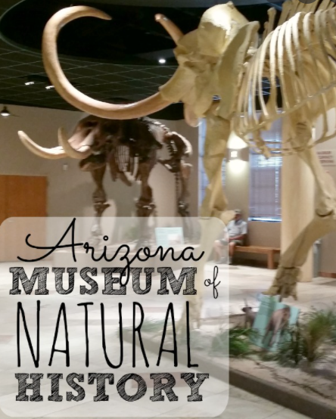

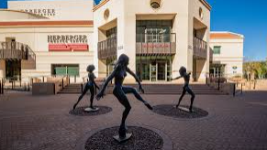
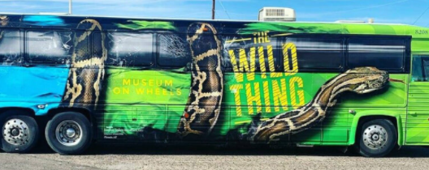

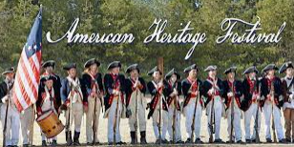
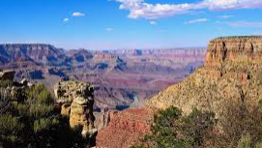
Each grade level organizes fieldtrips to enrich students’ education.
Past experiences have included:
The Wild Thing Bus
6th Grade Science Camp
Phoenix Zoo
Skateland (STEM projects)
American Heritage Festival/We Make History
Grand Canyon
Sonoran Desert Museum
Phoenix Symphony
Herberger Theater
AZ Natural History Museum
AZ Science Museum

Slide 18
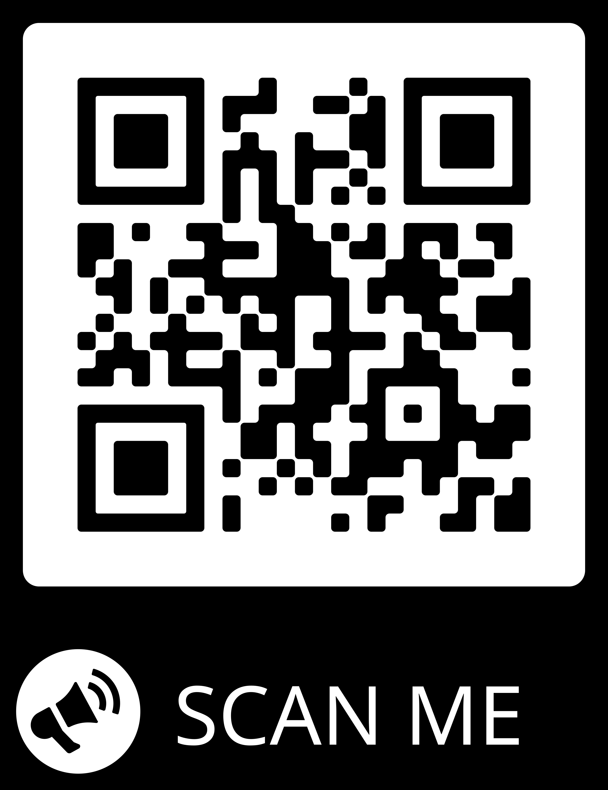



Slide 19
Classroom Helpers
Volunteers are always welcome in 2nd grade!
You can help with field trips, Art Masterpiece, copying, PTO, and classroom parties.
Volunteers must have volunteer forms on file in the office-Don’t forget to sign in!
Donations – I will send an email out when I need donations for the classroom. Our Room Parents will send out a sign up for parents to donate for classroom parties or special activities.
Please see Art masterpiece flyers if interested in volunteering.

Slide 20
Birthdays!
All treats must be store bought and prepackaged. They should be dropped off at the office or sent in with your child.
  NO CUPCAKES OR CAKE
Birthday invitations are not allowed to be handed out at school unless the whole class is invited.
Birthday deliveries (i.e. balloons) are not permitted in the classroom.

Slide 21

Communication
Open Door Policy… be sure to keep in touch! We are partners this year.
A newsletter emailed each week
Class emails – I add both parents to my group
Classroom Dojo can be reviewed at any time and push notifications
My phone goes directly to voice mail during school hours. Leave a message and I will call you back.
Email is the best way to contact me: boyd.leslie@cusd80.com

Slide 22
